Slide 1
Ashok Kumar – Data Analytics Trainer
19+ Yrs. Data Analytics Training - Power BI, SQL & Adv. MS Excel

Slide 2
Power BI
POwer Query, Power pivot & DAX

Slide 3
What is Power BI
Power BI is a suite of business analytics tools to analyze data and share insights. Monitor your business and get answers quickly with rich dashboards available on every device.

Slide 4
Power BI Installation
Power BI has Monthly new release
Microsoft Stores – Source to get latest update of Power BI
Open Source (Free License)

Slide 5
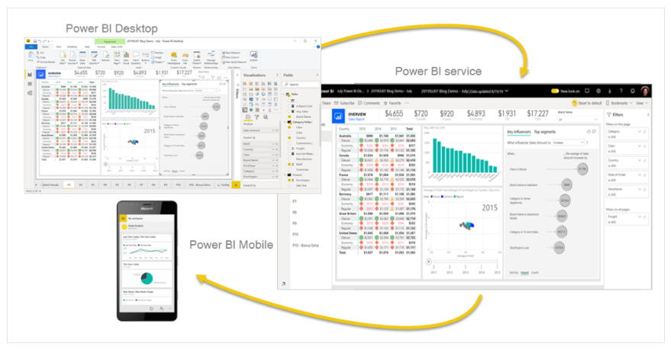
Power BI - Products

Slide 6
Business Intelligence and Data Analysis
It can help businesses make better decisions by providing insights and the ability to communicate them to decision-makers. When used together, they can help businesses gain a competitive edge and improve their bottom line.
Improve decision-making
Increase efficiency - BI can help businesses optimize internal processes and increase operational efficiency and productivity
Identify trends: BI can help businesses identify emerging business and market trends
Improve customer experience: BI can help businesses improve their customer experience.
Improve employee satisfaction: BI can help businesses improve employee satisfaction. For example, HR managers can use BI to monitor employee productivity and labor costs.

Slide 7
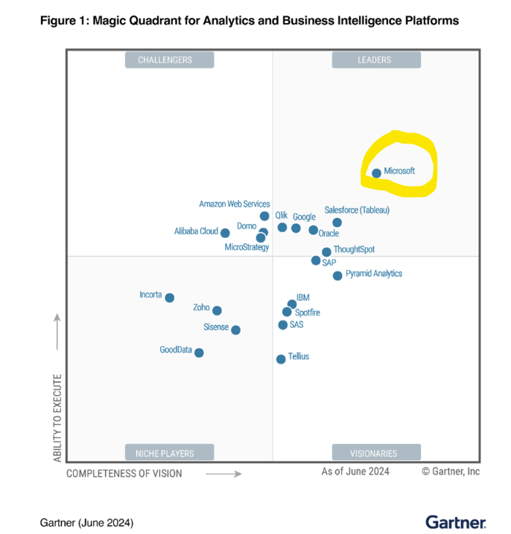
Gartner - Magic Quadrant – Jun 2024
Microsoft Power BI, Leader in Gartner's Magic Quadrant June 2024
https://powerbi.microsoft.com/en-us/blog/microsoft-named-a-leader-in-the-2024-gartner-magic-quadrant-for-analytics-and-bi-platforms/

Slide 8
Power BI - Architecture
Power Query:
ETL – Extract Transform Load
Data Cleansing
Transform
Model View / Power Pivot:
Data Modelling
DAX Calculation
Canvas / Report View:
Build Dashboards
Reports (.pbix)
Power BI Service Publish Reports or Datasets
Data Source 1
Data Source 2
Data Source 3

Slide 9
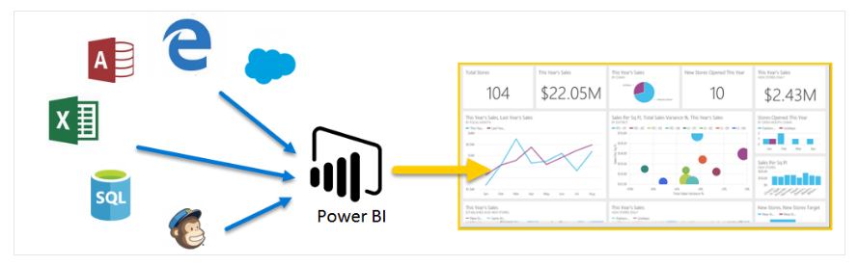
Power BI - Architecture

Slide 10
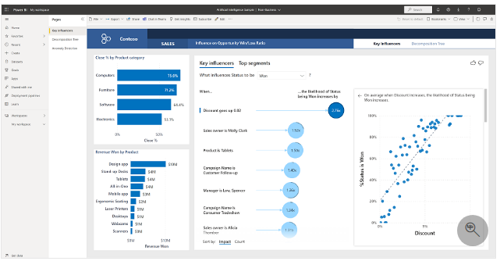
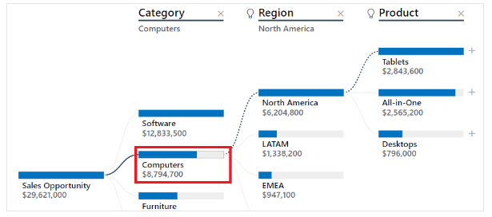
Artificial Intelligence with Power BI

Slide 11
Power BI
Power BI is Business Analytics Tool for Visualising and sharing Insights
Get data from 100’s of Sources with Power Query
Model your data with Power Pivot
Create Compelling, Interactive reports and dashboards
Collaborate and share reports inside and outside organization
Automatically refresh
Power BI - Components
Power Query
Power Pivot

Slide 12
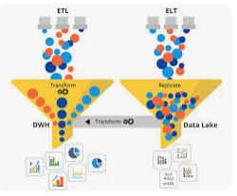
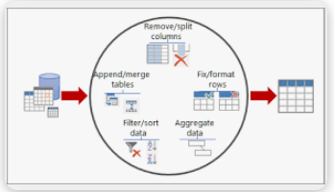
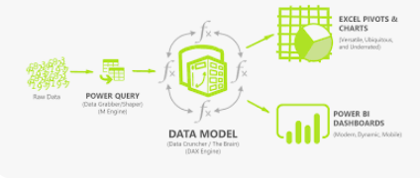
Power Query Editor
Power Query is Data Pre-Processor Engine
All Data cleansing tasks are recorded
Source data will not be changed/ affected with Data Cleansing task
Power Query is ‘Strongly’ Typed System (Data Type)
Click on Refresh Data for Data Source update

Slide 13
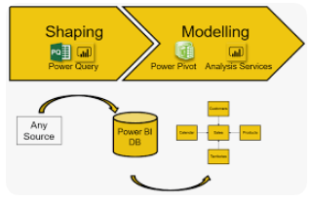
Data Modeling in Power BI
Schema
Star Schema
Snowflake Schema
Galaxy Schema

Slide 14
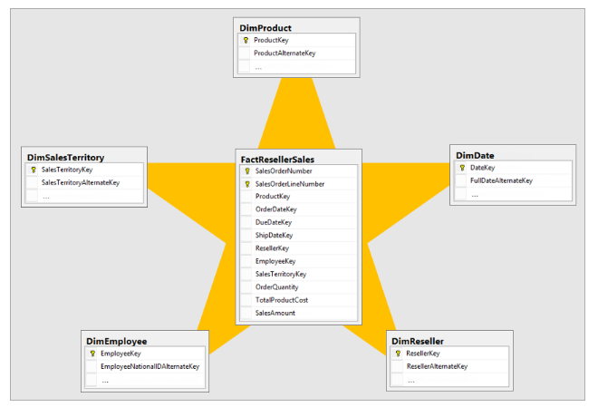
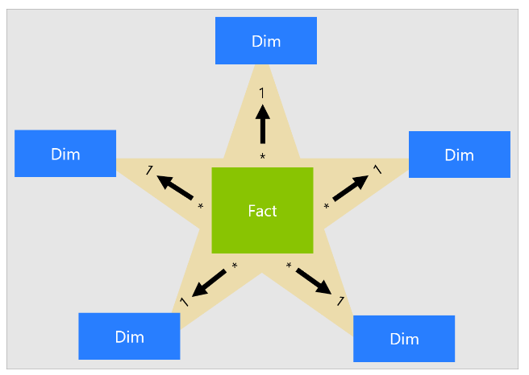
Star Schema

Slide 15
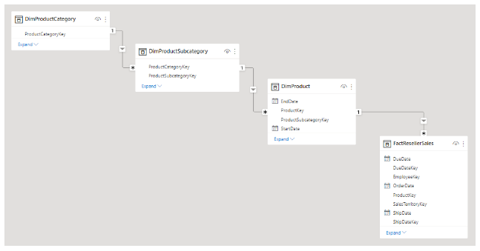
Snowflake Schema – Extension of Star Schema

Slide 16
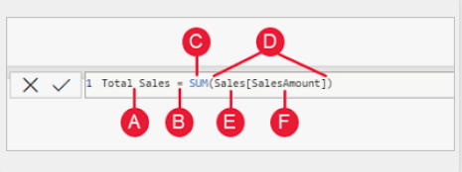
DAX – Data Analysis Expression Measures
DAX (Data Analysis Expression) Is a language used to create custom calculations in power BI, allowing you to manipulate and transform data within your reports
Measures are dynamic calculation formulas where the results change depending on context.
A - > The measure name, “Total Sales”
B -> The equals sign operator (=), which indicates the beginning of the formula. When calculated, it will return a result.
C -> The DAX function SUM, which adds up all of the numbers in the Sales[SalesAmount] column. You’ll learn more about functions later.
D -> Parenthesis (), which surround an expression that contains one or more arguments. Most functions require at least one argument. An argument passes a value to a function.
E - > The referenced table, Sales.
F - > The referenced column, [SalesAmount], in the Sales table. With this argument, the SUM function knows on which column to aggregate a SUM.

Slide 17
Power Pivot – Working Model
Power BI is like Car
Power Pivot is like Car Engine
Power Pivot
Filter Data
Calculates Value (DAX)

Slide 18
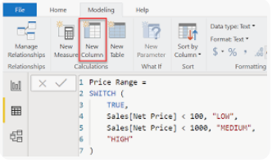
Measures
Measures are aggregates - returns single Value (Numbers/Text)
They are calculated during run time
Business Use Case:
Calculate Total Amount, Total Boxes, Average Sale,
Calculate Shipments Count

Slide 19
Power BI - Context
Row Context – Row context operates on one row at a time and is determined by the structure of the table
e.g., To create Calculated Column in Table
Filter Context – Filter context operates on a set of rows at once and is determined by the user's interaction with the data
Evaluation Context – Calculates in Front End Visuals
e.g., Measures used in Table Visualization

Slide 20
Types of Measures
Implicit Measure – e.g., Summation Symbol in Whole Number field of Table
Explicit Measure – e.g., Create New Measure & Format & use any where in Dashboard/Report

Slide 21
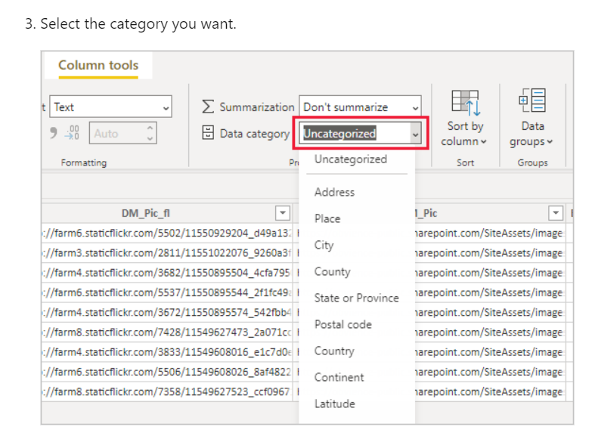
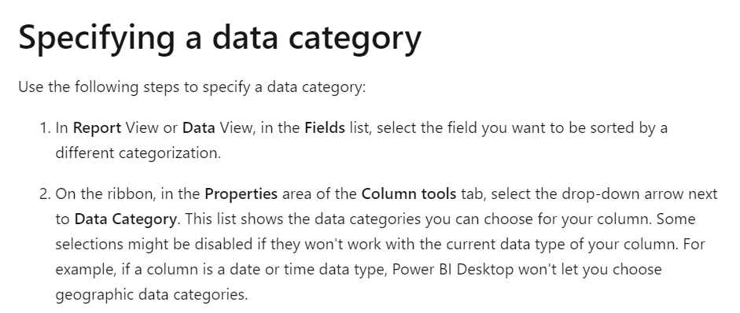
Data View - Data Categorization
In Power BI Desktop, you can specify the data category for a column so Power BI Desktop knows how it should treat its values when in a visualization

Slide 22
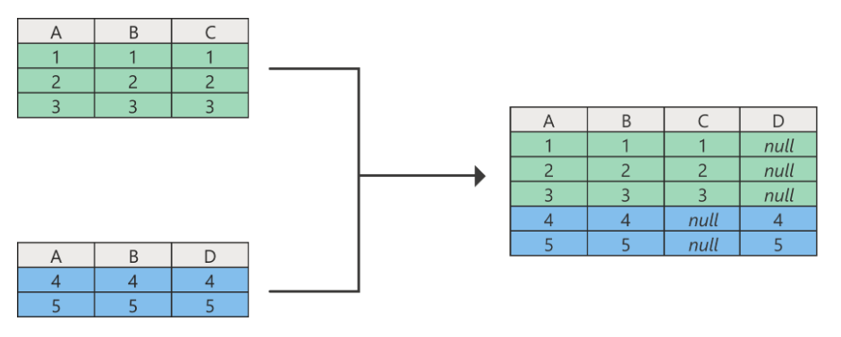
Power Query – Append Query
Append Query

Slide 23
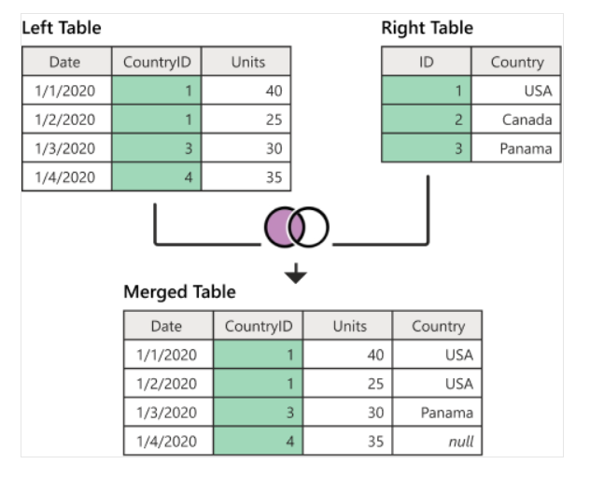
Power Query – Merge Query
Left Outer Join

Slide 24
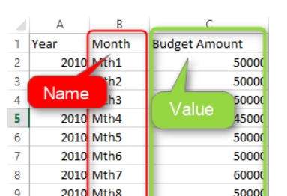
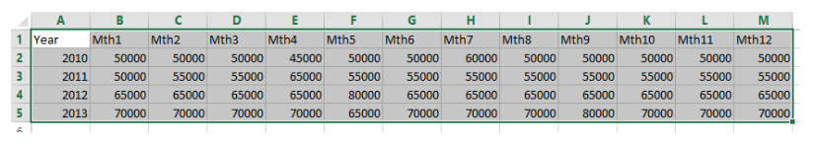
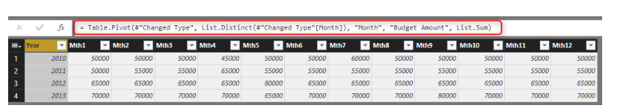
Power Query – Pivot & UnPivot
Pivot
UnPivot

Slide 25
ReUseability of DAX Measure
Business Use Case: (Cont’d)
Calculate Amount Per Shipment - Normal way (Lazy Way)
Calculate APS 2 - Reusability ( Faster and More Optimized way)
Calculate Amount Per Box (Explain no table name for Measure - Best Practice)
Calculate APB 2 - Div/0 Error & Divide() Function
Check Target achieved by Sales person( Target 5000)
FUN DAX Trick - Visual Indicator - Emoji "Windows Key" + "."

Slide 26
How to use CALCULATE() to change the "FILTER" criteria
Calculate Low Box Shipment Box (count of # Box below 50)
Calculate LBS %
Calculate Bar Shipment & %
Calculate Americas Shipment - Overrides Page filter

Slide 27
DAX Measures vs. Columns
Adding Column in Table - Internally Power Pivot uses Row Context
Calculate new column "WeekDay"
Calculate Friday Amount, Alternate Way to create Friday Amount 2

Slide 28
Variables, OR conditions, IN operator
1. Calculate Total Amount for NZ and Aus (using Or Condition)
2. Calculate Total Amount for NZ and Aus ( using “In” Parameter)

Slide 29
DAX – Sum vs SumX Function
Sum –
SUM function considers a single column of data to add all the data in that column
Syntax: Sum(<Column Name>)
DAX Measure -> Total Units = SUM(Sales[Price])
SumX –
SUMX is an iterator function and takes a different approach.
Unlike SUM, SUMX is capable of performing row-by-row calculations and iterates through every row of a specified table to complete the calculation.
SUMX then adds all the row-wise results of the iterations of the given expression.
Syntax: SumX( <Table>,<Expression>)
DAX Measure -> Actual Sales = SumX(Sales, Sales[Price] – (Sales[Price] * Sales[Discount]))

Slide 30
Power BI – Filters Type
Visual Filter – Only for Selected Visual
Page Filter – Filter applied for all the visuals in a Page
Report / All Page Filter: Filters applied for all Pages in Power BI Report

Slide 31
Power BI – Interaction Type
Highlight (Default)
Filter
No Interaction

Slide 32
Create Date Table using DAX
CalendarAuto()
Calendar(StartDate,EndDate)

Slide 33
DAX– Calculate – Multiple Filters
Calculate: Evaluates an expression in a modified Context
Syntax: Calculate(<Expression>, Filter1,Filter2…..)
e.g, Furniture_Sale = Calculate(Sum(Order[Sale]), Order[Category] = “Furniture”)
Filters Can be:
Boolean filter Expression
Table Filter Expression
Filter Modification Functions

Slide 34
Power BI – Filter Context Types
Visual Filter
Outside Filter – (Page Filter, Report Filter, Slizer)

Slide 35
DAX– Filter() & Filters()
Filter() - Returns a table that has been filtered
e.g., Filter ( <Table Name>, Color = “Red”)
Filters() – Returns a Table with Single Column
e.g., Filters(sales[Color] = “Red”))

Slide 36
DAX– Values () vs Distinct ()
A column of unique values if the parameter is a single (can have an additional blank row)
If the parameter is a table expression, the result has the same columns and does not remove duplicated rows
E.g., Values(‘Sales’[Continent])
Distinct – Returns Unique Value (No Blanks)

Slide 37
DAX – All, AllSelected, AllExcept
All
Returns all the rows in a table, or all the values in a column, ignoring any filters that might have been applied
It removes both visual and outside filter
AllSelected
It removes visual and considers outside filter
AllExcept
Consider only the columns provided in AllExcept Function
It considers both visual and outside filters

Slide 38
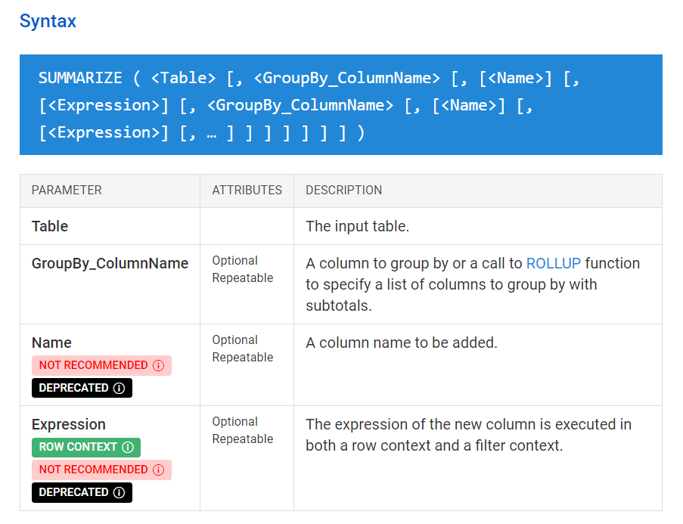
DAX– Summarize ()
Creates a summary of the input table grouped by the specified columns

Slide 39
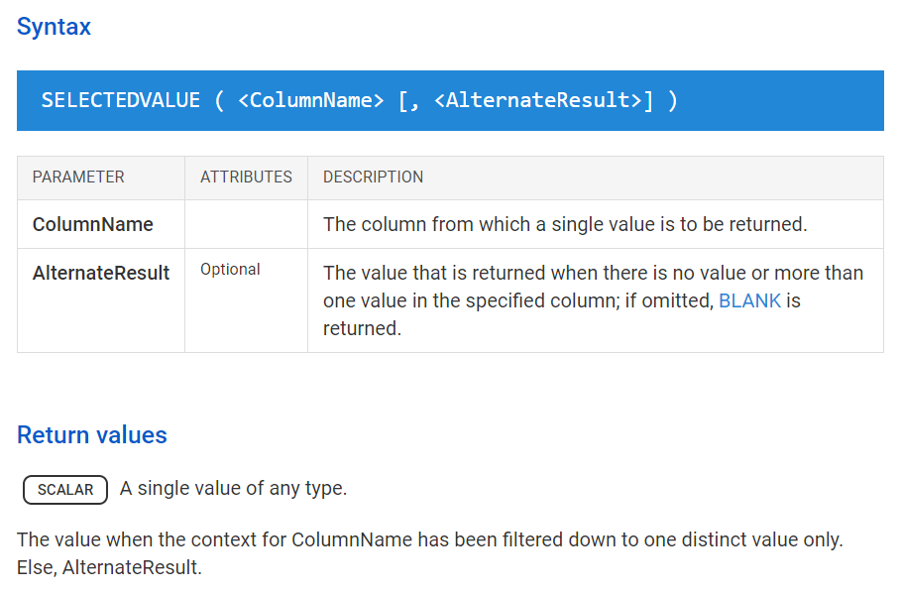
DAX– SelectedValue ()
Returns the value when there’s only one value in the specified column, otherwise returns the alternate result.

Slide 40
Dynamic Column/Measure Name
Create Field Parameter in Model View

Slide 41
DAX– Context Transition
It is the transformation of row contexts into an equivalent filter context performed by Calculate and CalculateTable DAX Function
e.g., Calculated Column = Calculate(Sum(Orders[Sales])
Options to make Context Transition:
Create a measure (with/without Calculate Function)….use that measure in Other DAX Expr.
Use Calculate function in the measure

Slide 42
Drill Down – Bar Chart

Slide 43
WaterFall Chart

Slide 44
Decomposition Tree

Slide 45
ConcatenateX
Concatenates the result of an Expression evaluated for each row in a table
Syntax: ConcatenateX(<table>, <Expression>,[delimiter])
Concatenate: It concatenates two strings -
Strings can include text or Numbers
Syntax: Contatenate(<text1>,<text2>)

Slide 46
Database - Connectivity Mode
DirectQuery to Import
Import to DirectQuery

Slide 47
3 Ways of Top/Bottom Analysis – (Static Method)
Filter in Filter Visualization
Use Power Query Editor to create Top N Table
DAX Table – TopN() & Summarize()

Slide 48
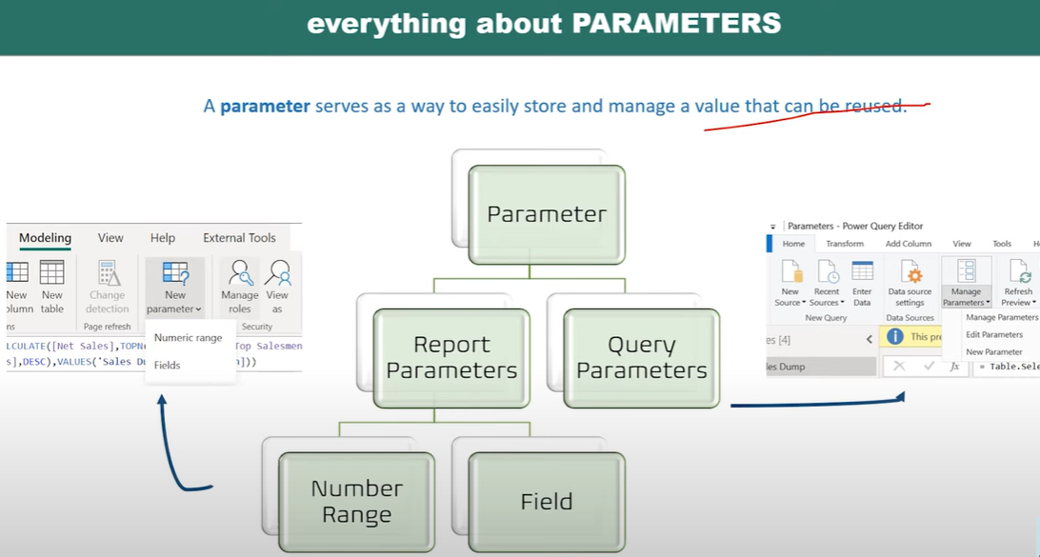
Power BI - Parameters
Query Parameters - Power Query
Limits Data Set
Report Parameters - Model View
Limits Data in Visual
Case Study: Top/Bottom Sales
Static Method
Dynamic Method

Slide 49
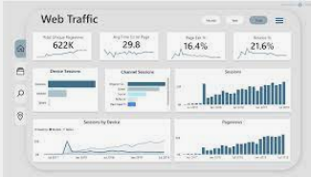
Dashboard / Report
Prepare Dashboard in Canvas using Visualization Tools

Slide 50
Questions ?
Q & a

